Slide 1
Spectroscopy and diffraction gratings

Slide 2
What do you see?
Why do you see this?
In this lesson, we will explore this effect.

Slide 3
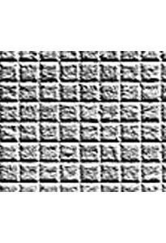
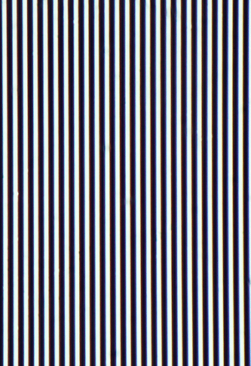
Close up of the glasses
Very small lattice, only part of the light goes through.
This is called a diffraction grating.
Notes:
1:15 test

Slide 4
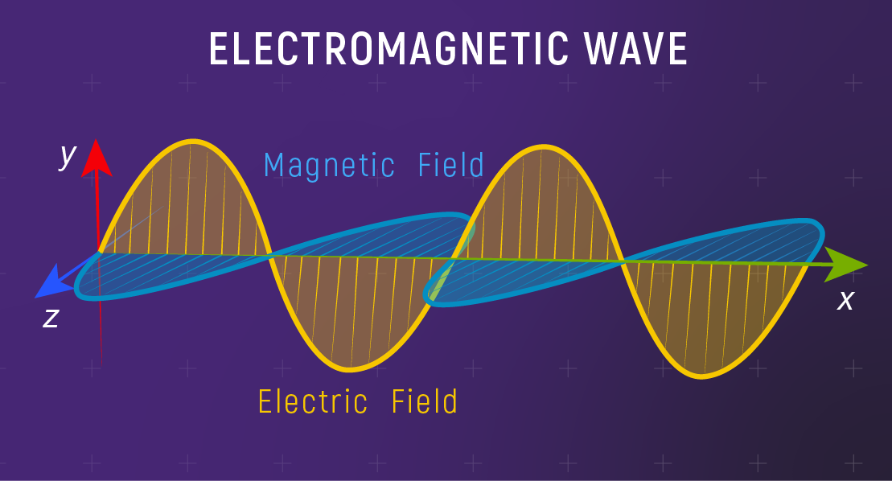
Light is a wave
They are waves in the electromagnetic field, but you don’t have to know about that.
Most importantly: they behave like waves!
Notes:
0:45 test

Slide 5
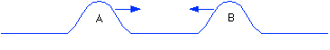
What do you know about waves?
Discuss and write down a list of what you already know about waves.
Do this for 1.5 minutes.
After that, we will discuss your answers in class.
Questions to get you started:
What characterises a wave?
Where do you see waves?
What do you already know about how these waves behave?
What happens when two waves are travelling towards each other?
Notes:
Misschien mentimeter ofzo

Slide 6
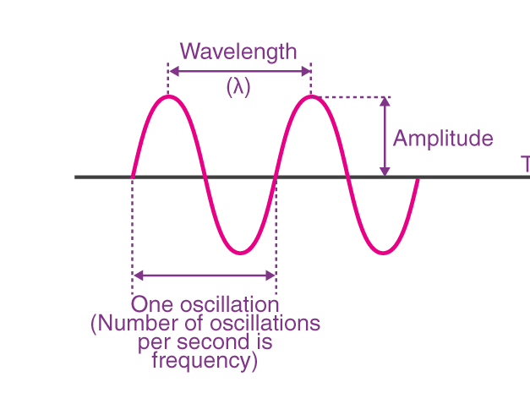
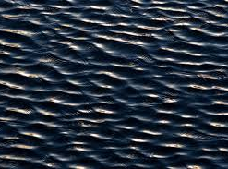
Water waves
They are just like light waves; they show similar behaviour.
Using water waves, we can see what happens with the light waves.
Make a prediction for water waves hitting the diffraction grating.
Connect to physics in the glasses.
Notes:
3:10 test

Slide 7
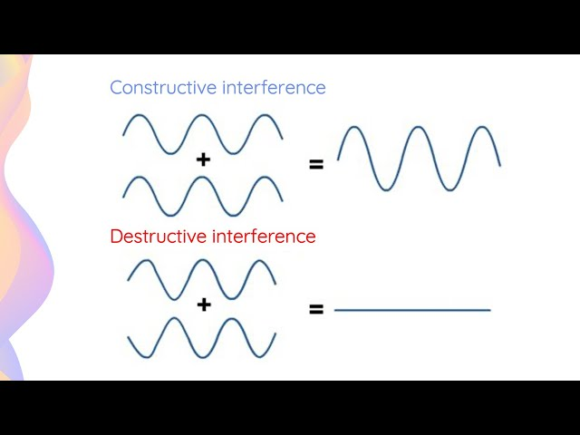
Superposition of waves
Adding waves together
Some cancel out (destructive interference), some add up (constructive interference)
Notes:
2:45 test

Slide 8
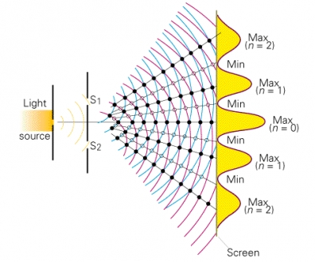
Constructive and destructive interference with two slits
Black = where both peaks are at the same point
White = where peak aligns with troughs

Slide 9
Notes:
Een slide met een slit open en een slide met de andere slit open en dan bij elkaar doen?
6:30 test

Slide 10
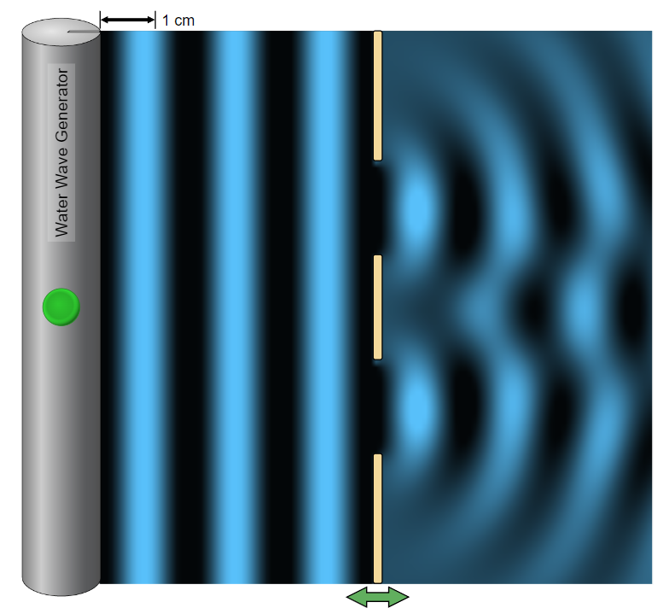
Test it yourself!
Go to this link: wave interference simulation – slits
Answer the following questions:
Can you see region of constructive and destructive interference?
What happens when you change slit size?
What happens when you change slit separation?
If time permits: can you think what a graph of maximum water level on the y-axis and position on the x-axis looks like? Tip: use the instrument right above.
After 4 minutes, we will discuss the answers in class.
You are allowed to quietly discuss the questions with your neighbour.
Notes:
Eerst voordoen hoe de simulator werkt, dan zeggen pak de laptop. Leg uit dat blauwer = hoger

Slide 12
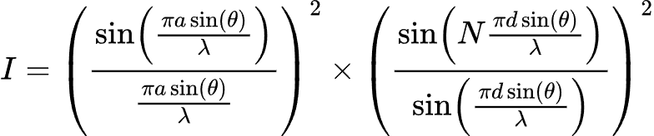
What happens when waves hit a diffraction grating?
a = slit width
d = slit separation
N = amount of slits
λ = wavelength
ϑ = angle from middle
I = intensity (related to wave amplitude)
Notes:
I=\left ( \frac{\sin(\frac{\pi a\sin(\theta)}{\lambda})}{\frac{\pi a\sin(\theta)}{\lambda}}\right)^2\cross \left( \frac{\sin(N\frac{\pi d\sin(\theta)}{\lambda})}{\sin(\frac{\pi d\sin(\theta)}{\lambda})}\right)^2

Slide 13

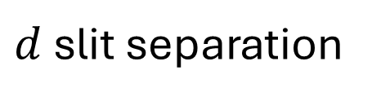
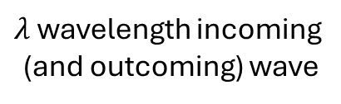

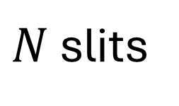
$λ$ wavelength incoming
(and outcoming) wave
$d$ slit separation
Projection screen
$θ$ angle to center of screen
Diffraction grating
$a$ slit width
$N$ slits
Notes:
Dit boven de afbeelding van de simulatie

Slide 14
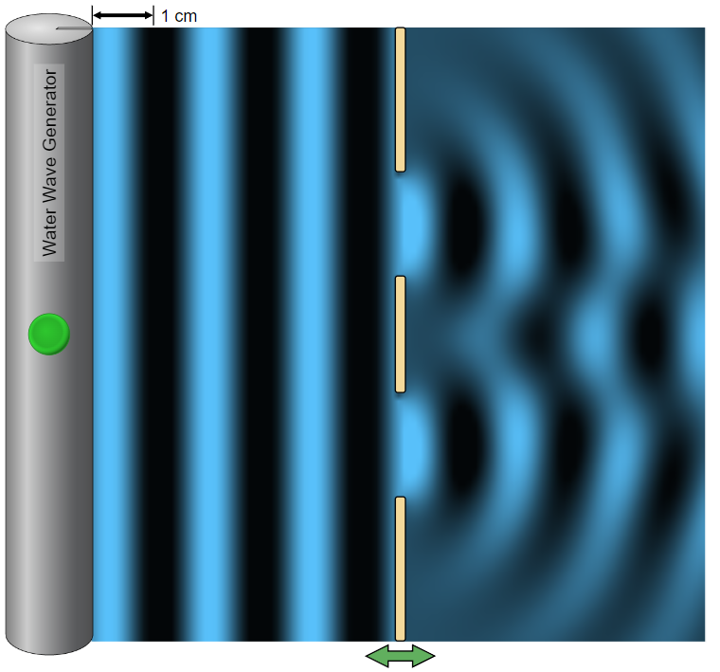
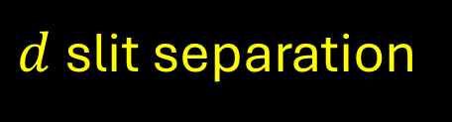
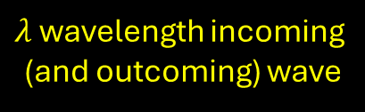
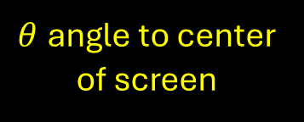
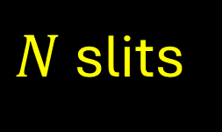

$λ$ wavelength incoming
(and outcoming) wave
$d$ slit separation
Projection screen
$θ$ angle to center of screen
Diffraction grating
$a$ slit width
$N$ slits
Notes:
Dit boven de afbeelding van de simulatie

Slide 15
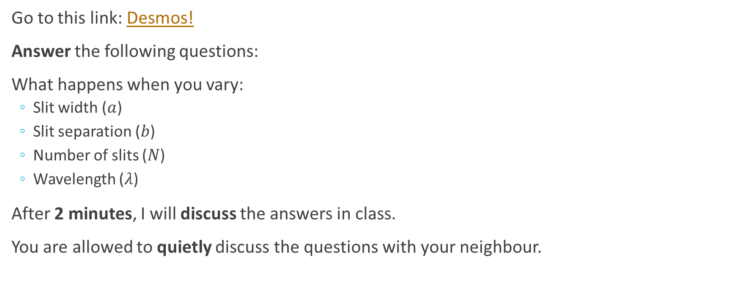
Try it yourself!
Go to this link: Desmos!
Answer the following questions:
What happens when you vary:
Slit width ($a$)
Slit separation ($b$)
Number of slits ($N$)
Wavelength ($λ$)
After 2 minutes, I will discuss the answers in class.
You are allowed to quietly discuss the questions with your neighbour.
Notes:
Eerst uitleggen hoe Desmos werkt, dan laptop pakken

Slide 16
Practical
Does this work in the real world?
Questions to answer:
Does our setup work?
Do we see the graph we just saw in reality?
What happens when you change the wavelength (i.e. the motor spins at different speed)?
What happens when we change the diffraction grating?
Notes:
Kamer donker maken

Slide 17
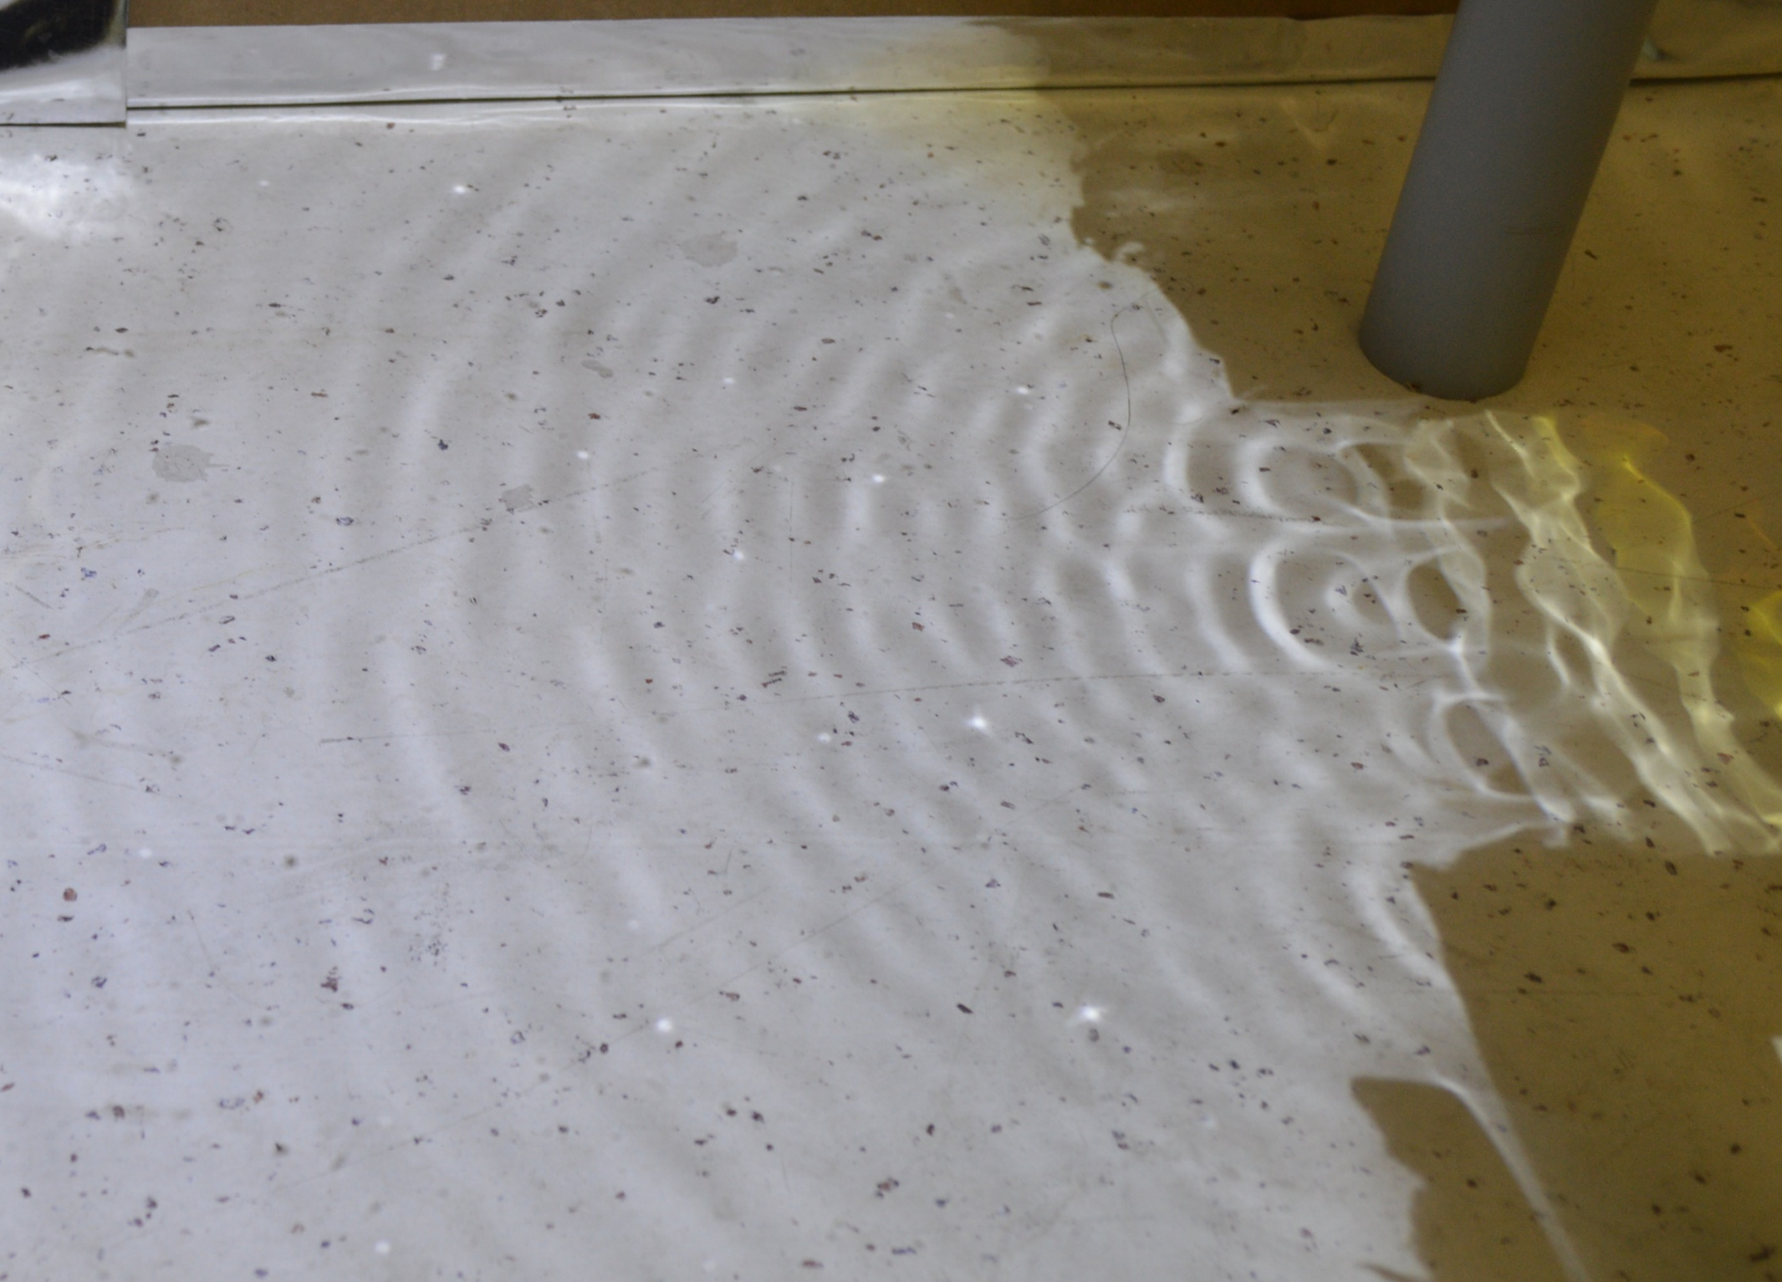
Can you see the pattern?

Slide 18
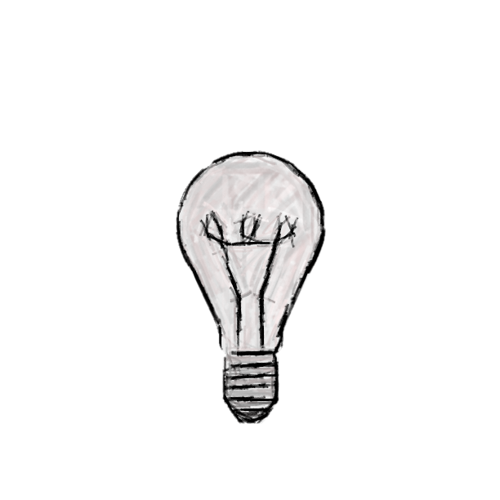

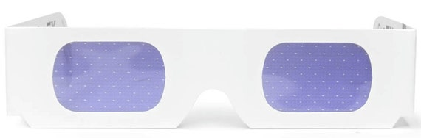

What happens in the glasses?
Notes:
Kleur = golflengte

Slide 19
What do we do with this?
Discuss in groups why separating light by its colour is useful to science and society.
After 2 minutes, I will discuss the answers in class.
You are allowed to quietly discuss the questions with your neighbour.

Slide 20
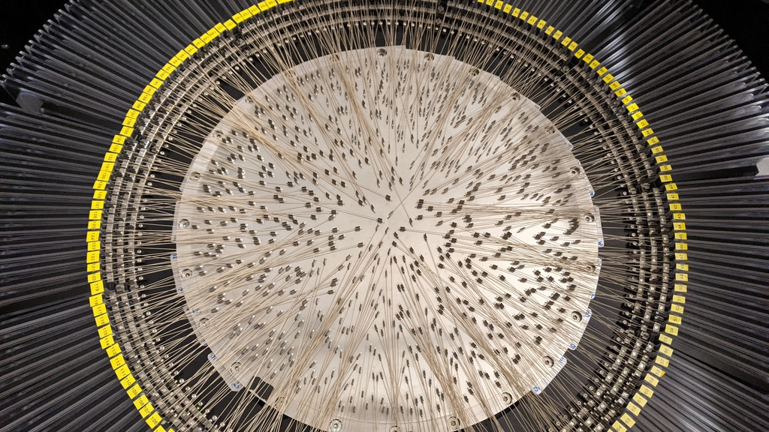
Spectroscopy!
Separating light to do science!

Slide 21
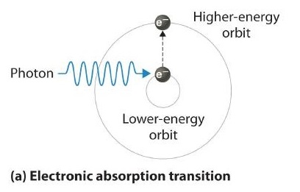
A little bit of quantum mechanics
A molecule or an atom can absorb a light wave when it passes through, but only when it has the right colour.
What the right colour is, is unique to every molecule!
This is caused by quantum mechanics, but you don’t have to learn this.

Slide 22
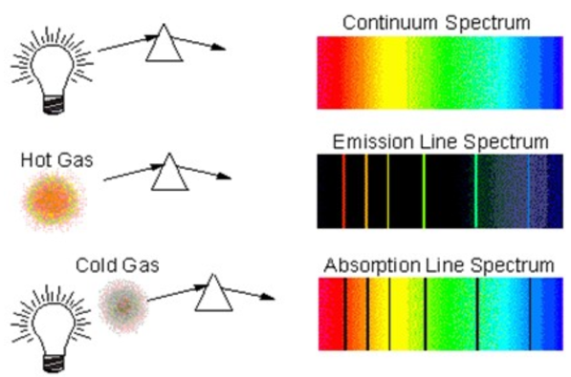
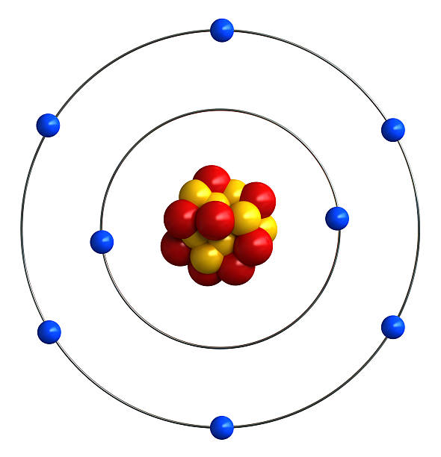
A molecular bar code

Slide 23
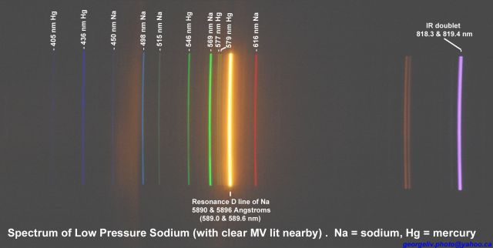
Spectrum of sodium lamp

Slide 24
What can we use this for
Discuss in groups what kind of practical applications of spectroscopy you can think of
2 minutes of discussing
After that, we will discuss what you produced. Keep your best 3 ideas in mind!

Slide 25
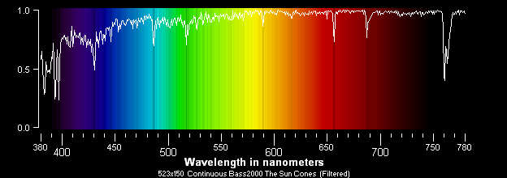
Spectrum of the Sun
What is the sun made of?
Discovery of helium (Helios = sun)
Please don’t look directly at the sun

Slide 26
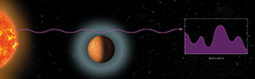
Exoplanet science
Light passes through an exoplanet’s atmosphere, gets partly absorbed
An exoplanet is a planet outside our solar system.
Determine composition of atmosphere by analysing said light
Find out if life is possible
Notes:
Uitleggen wat een exoplaneet is

Slide 27
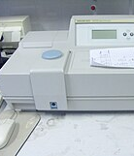
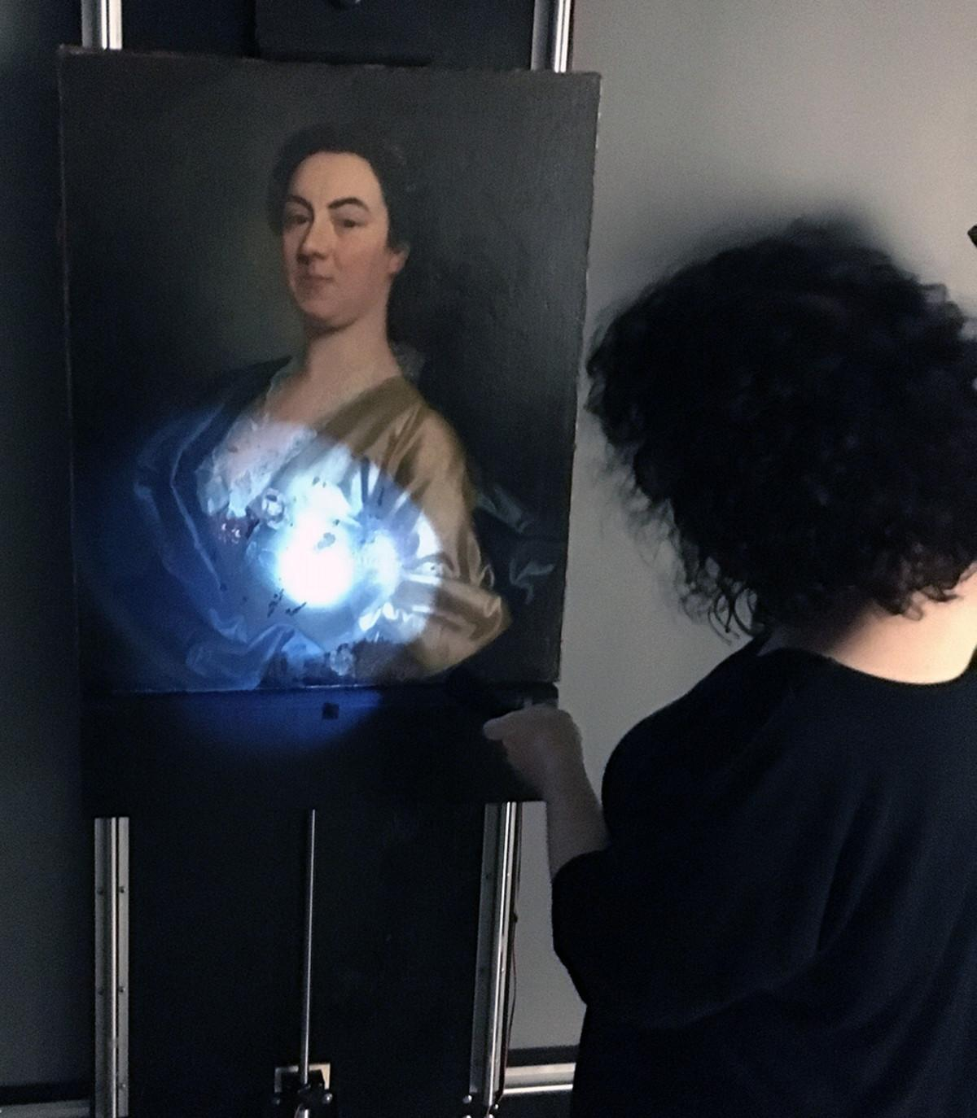
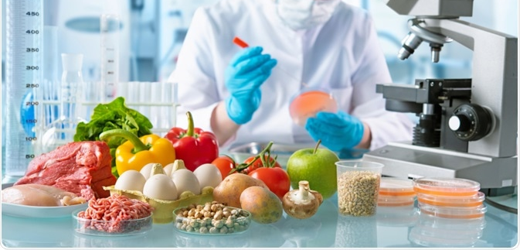
Discover what things are made of
Spectrophotometry: measuring what, and how much of a molecule is present in a sample
Used for:
Authenticating artwork
Water purity testing
Food quality control
And much more!

Slide 28
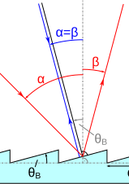
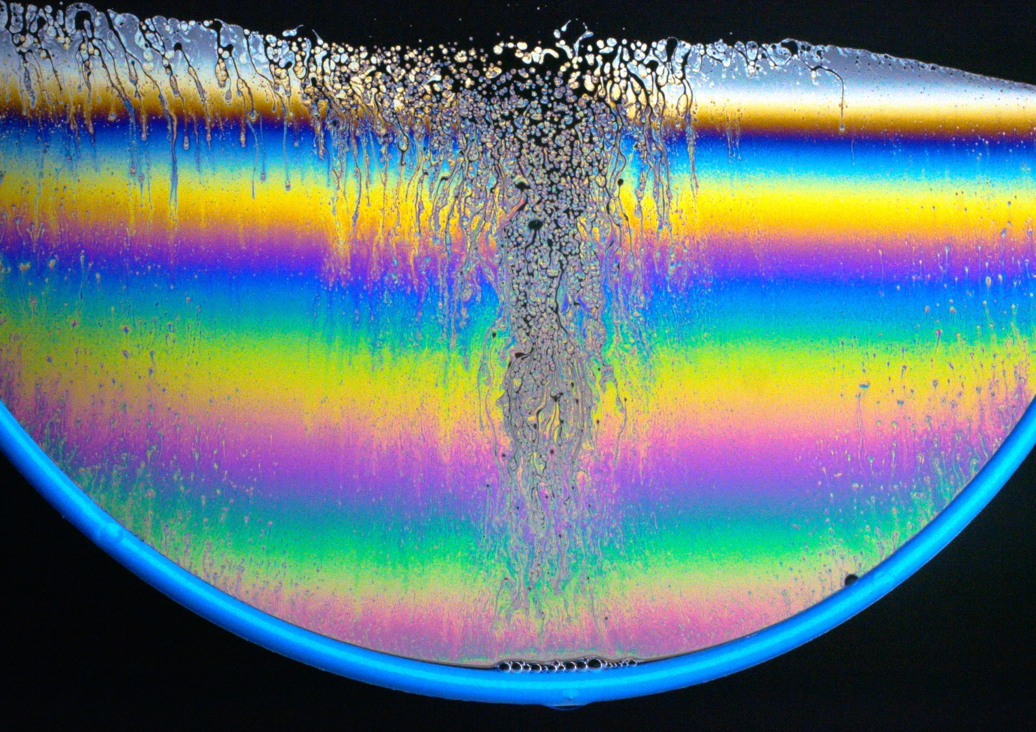
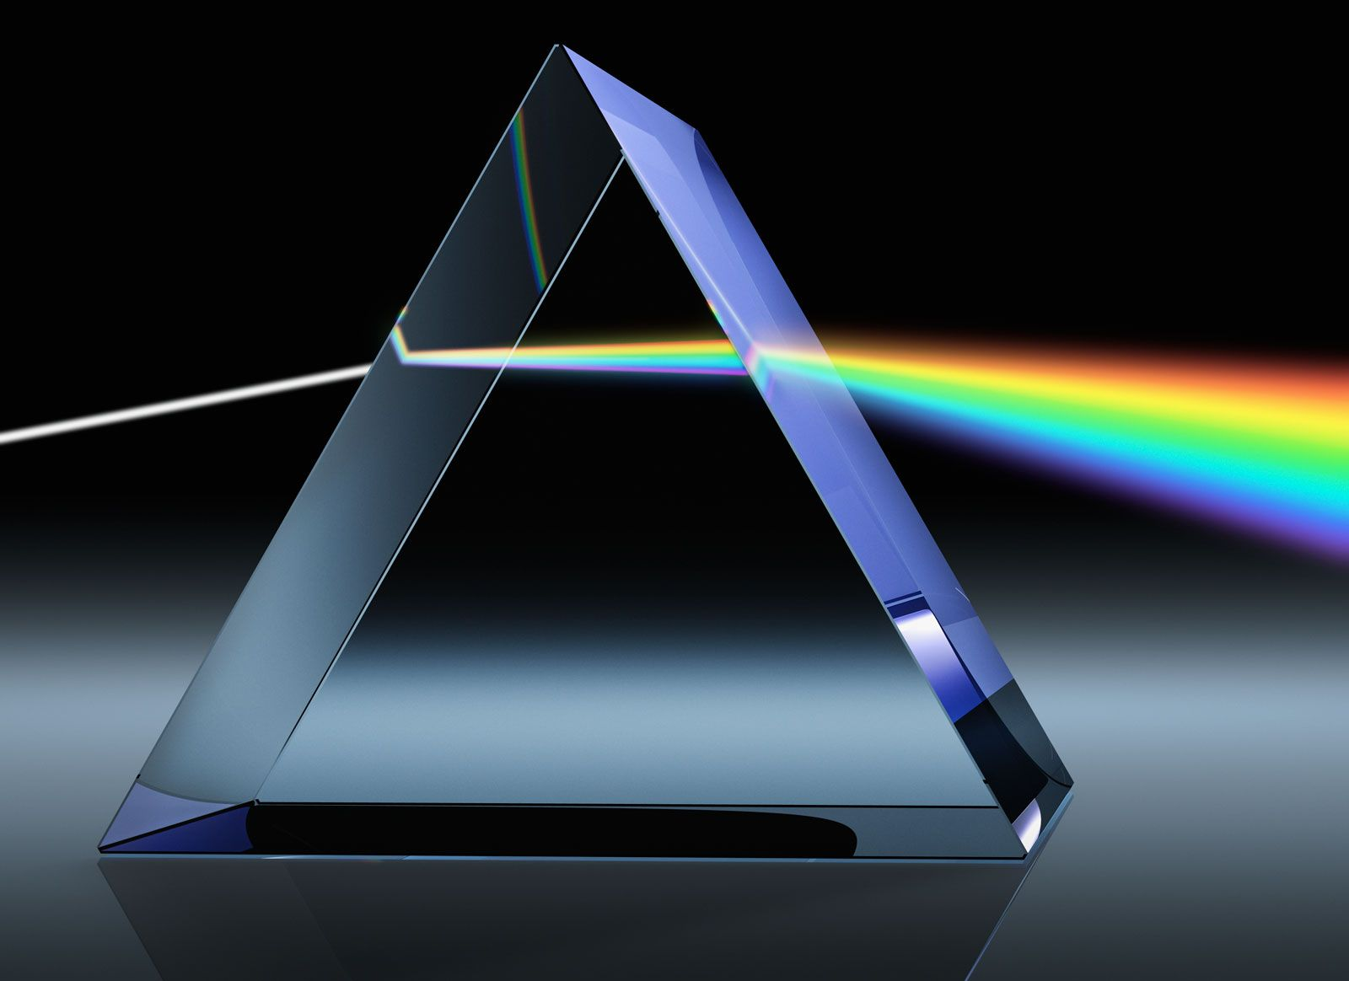
Other ways of separating light
Prism: glass bends light differently depending on colour
Blazed grating: cleverly reflecting incoming light
Thin film interference: light waves of certain sizes reflect of a layer to interfere with themselves
Notes:
Prisma lenen

